Slide 1
Data warehouses and business intelligence
explaing the design and implementation of a small data warehouse

Slide 2
Solution implementation
-Implementation goals
The goal of the implementation is to create a functional data warehouse.
-System architecture
The system is based on Microsoft SQL server RMDBS
-Technologies and tools being used
Microsoft SQL server, SQL server management studio 18, Microsoft Visual Studio 2019 and extensions SQL server analysis services and SQL server integration services. And Power BI Business Intelligence Front-End development tool

Slide 3
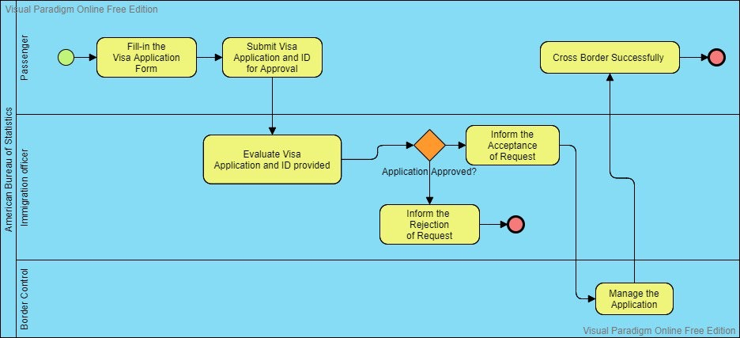

Slide 4
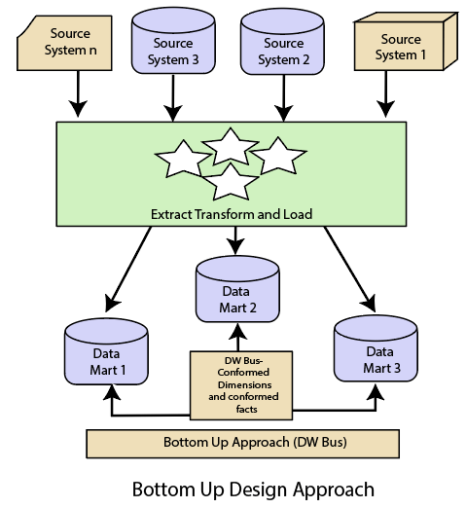
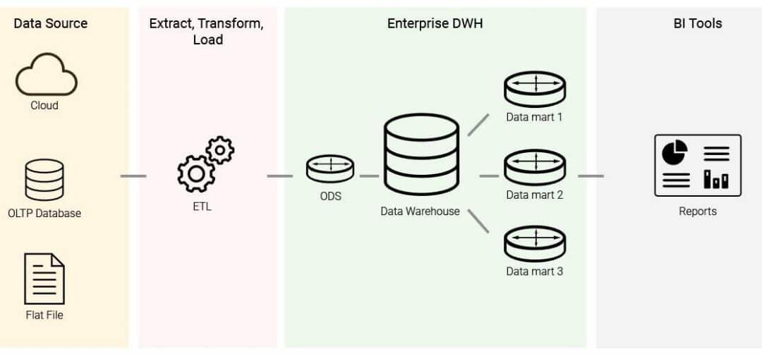
Bottom-Up Design Approach

Slide 5
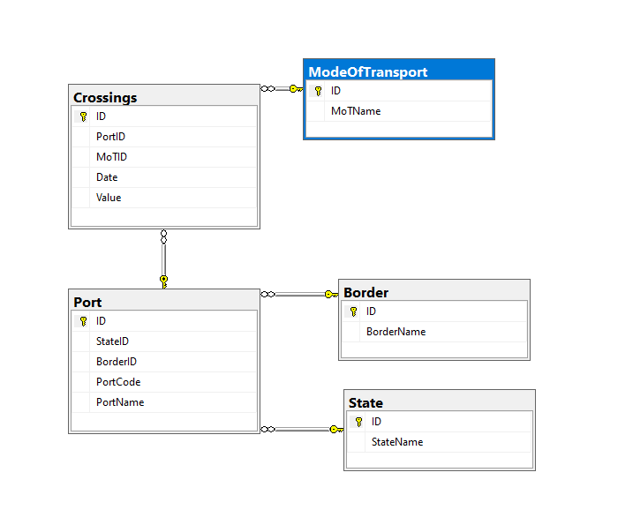
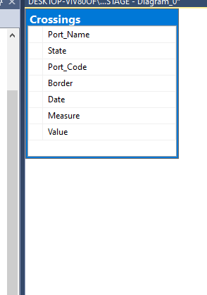
Transaction database & Data warehouse

Slide 6
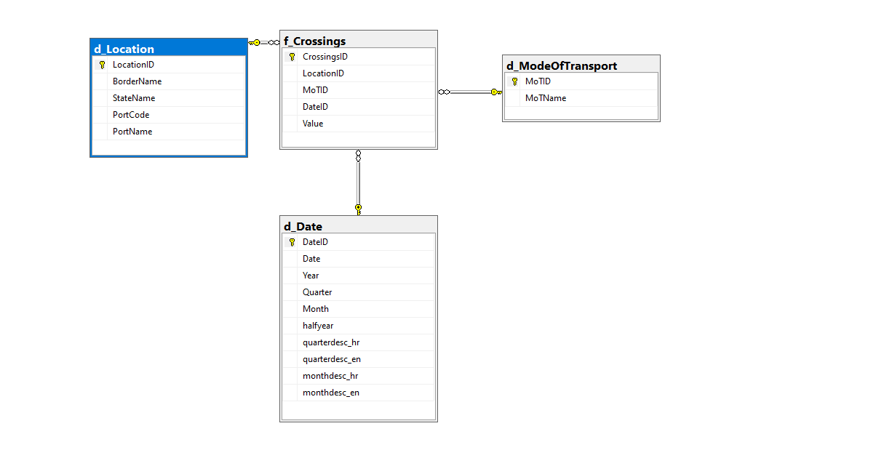
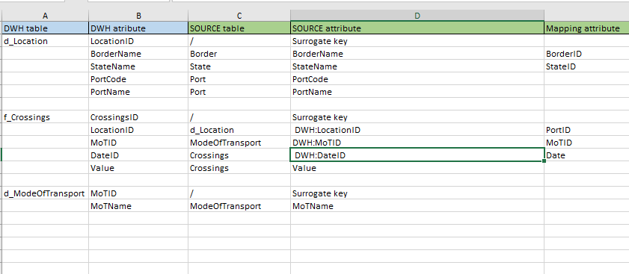
Transaction database & Data warehouse

Slide 7
Users of this DWH are interested in answers to the following questions: •How many people crossed the border annually / quarterly / monthly per individual border? •How many people entered the United States each year? •Which method of transport crosses the border the most people (total so far / by country / year)? •Which is the busiest country in total / by years / per month in a year? •What is the busiest month of the year (aggregated for all years)? •Which country has entered the most pedestrians so far? •Which country has received the most trucks so far? •Which year and month are the busiest so far? •What is the busiest border crossing by year / per month / in total so far?

Slide 8
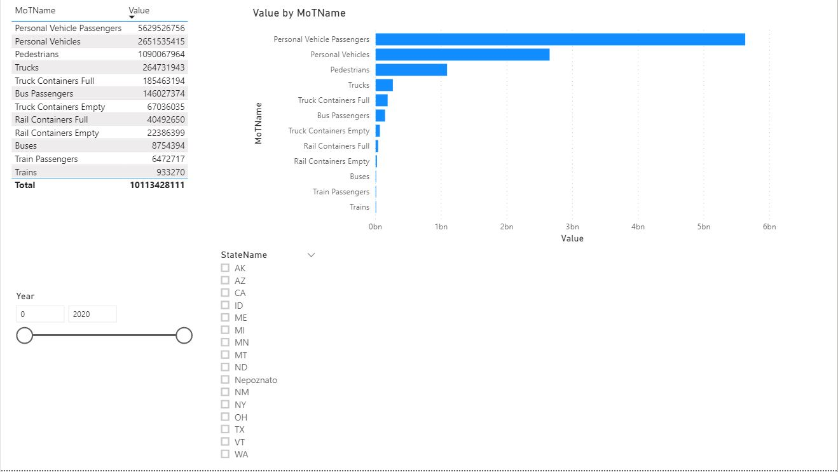
Which method of transport crosses the border the most people (total so far / by country / year)?

Slide 9
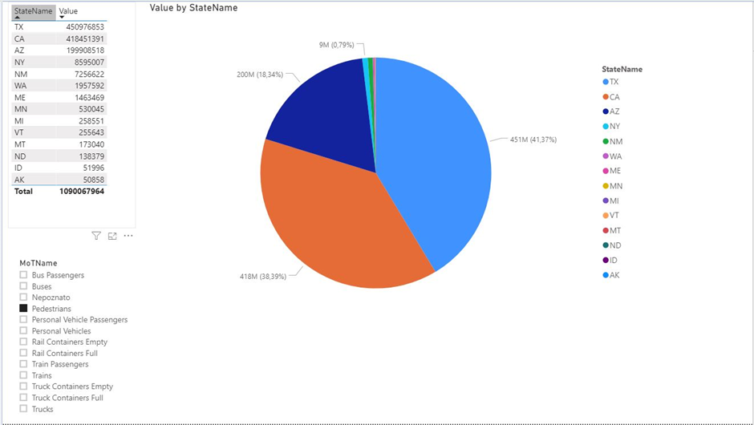
Which country has entered the most pedestrians so far?

Slide 10
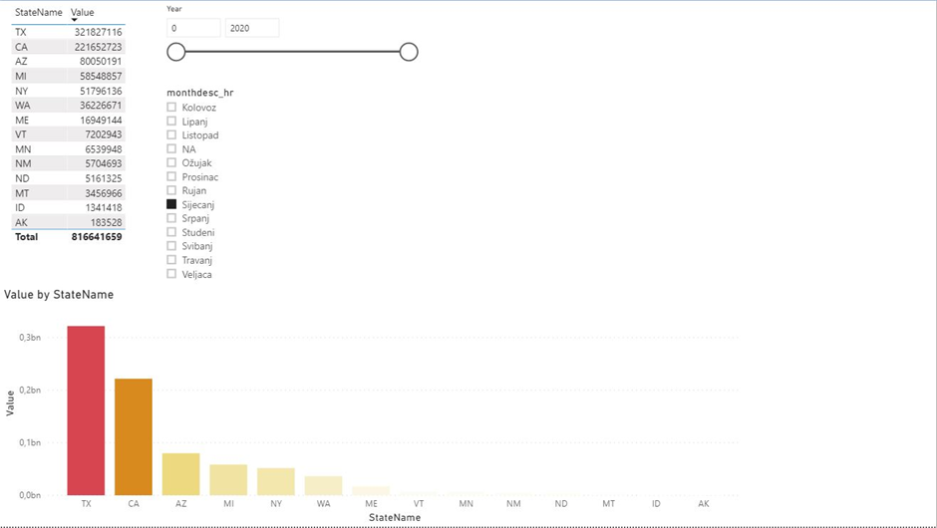
Which is the busiest country in total / by years / per month in a year?

Slide 11
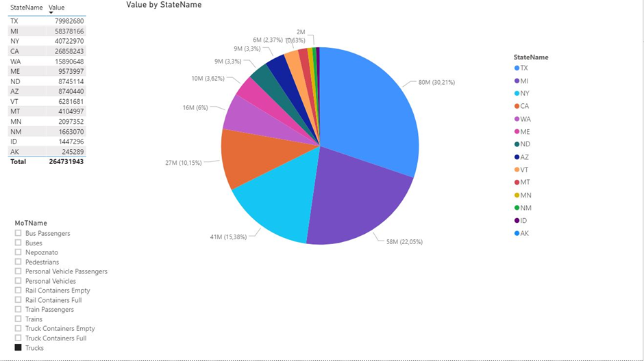
Which country has received the most trucks so far?

Slide 12
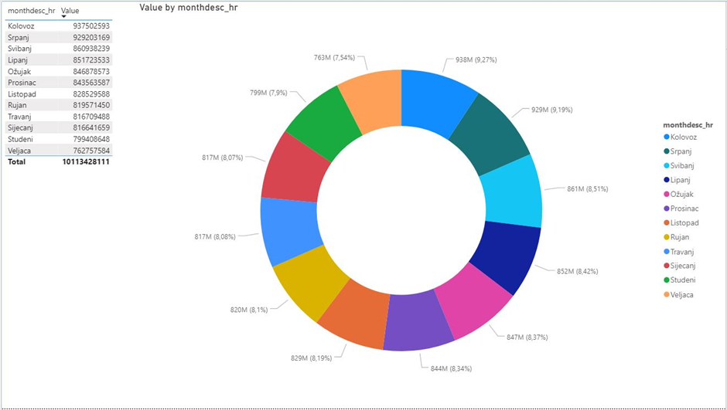
What is the busiest month of the year (aggregated for all years)? (Note: not so functional chart, but chosen purely to try out other visual options in Power BI)

